Slide 1




HOPE TO SKILL
Lecture 33
Transformers
In Deep Learning
Artificial Intelligence Advance Course

Slide 2


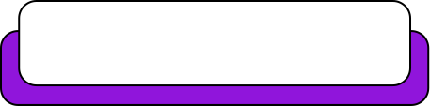
Dedicated to my late Teacher, a beacon of Knowledge.
Your Guidance shaped me; now I shape others through
a free course.
YOUR LEGACY LIVES ON!

Slide 3




AI INSTRUCTORS
Dr.Irfan Malik
Dr.Sheraz Naseer
Dr.Shazia Saqib
M.Haris Tariq

Slide 4



Previous Lecture Topics
01
Recurrent Neural Networks
02
LSTM
03
GRU

Slide 5
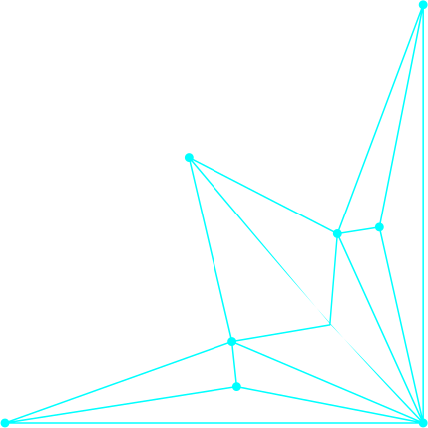
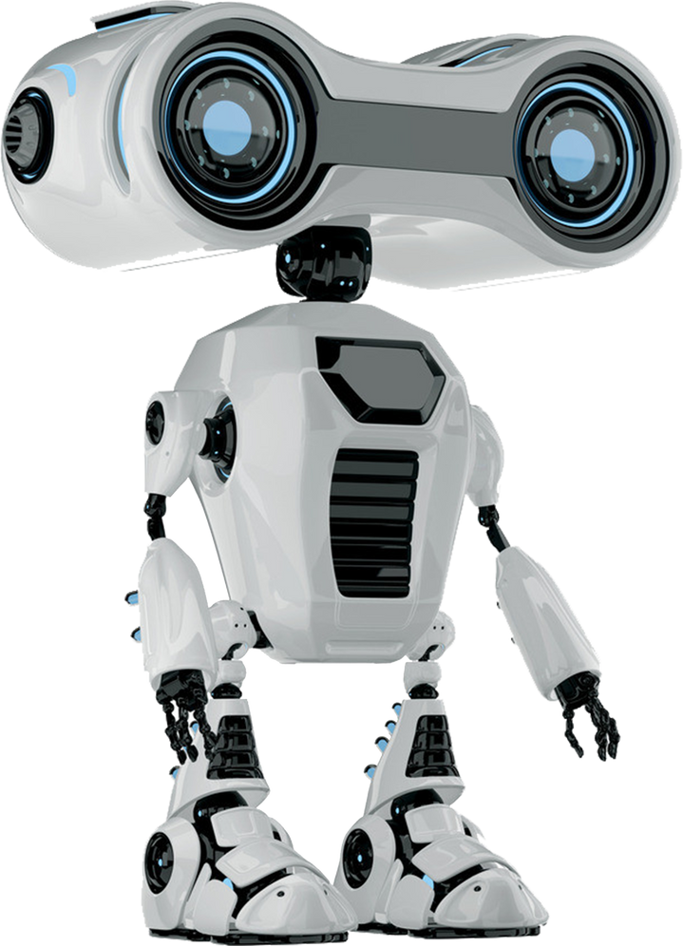

Outline
Introduction to AI and Learning
Challenges with Traditional Learning Models
Concept of Attention
Mechanics of Attention
Introduction to Transformers and GPT

Slide 6
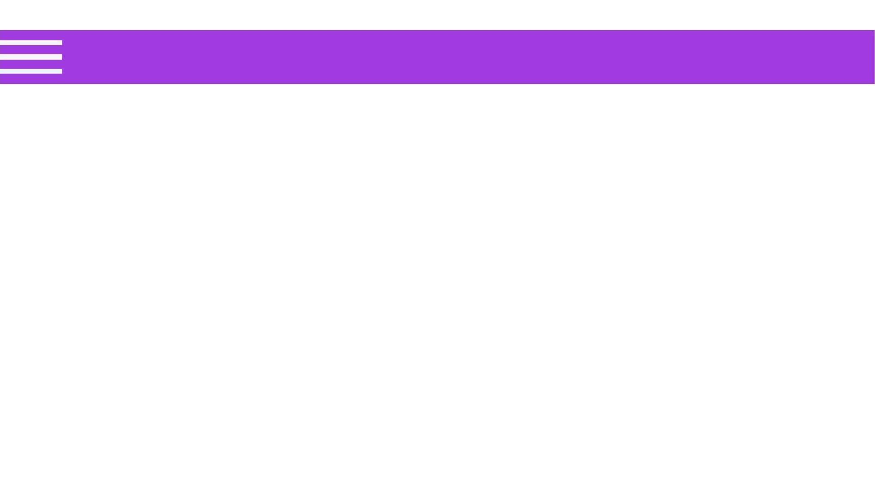
The Seq2Seq Model
The Encoder-Decoder Model with RNNs/Sequence-to-sequence
(seq2seq) models in NLP are used to convert sequences of
Type A to sequences of Type B.
Example: translation of English sentences to Spanish sentences is a sequence-to-sequence task.
Input (English): "Good morning."
Output (Spanish):
"Buenos días."

Slide 7
Models Architecture
Encoder-Decoder Networks/Seq-2-Seq Models Architecture
Encoder-decoder networks consist of three conceptual components.
Encoder
Context Vector
Decoder

Slide 8
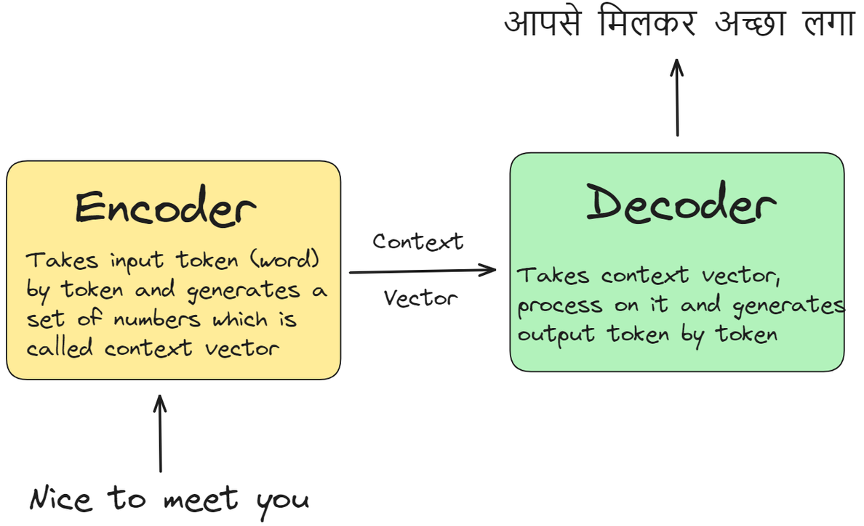
Encoder
Under the hood, the model is composed of an
encoder and a decoder.
Encoder Process
The encoder processes each item
in the input sequence, it compiles
the information it captures into
a vector (called the context).

Slide 9
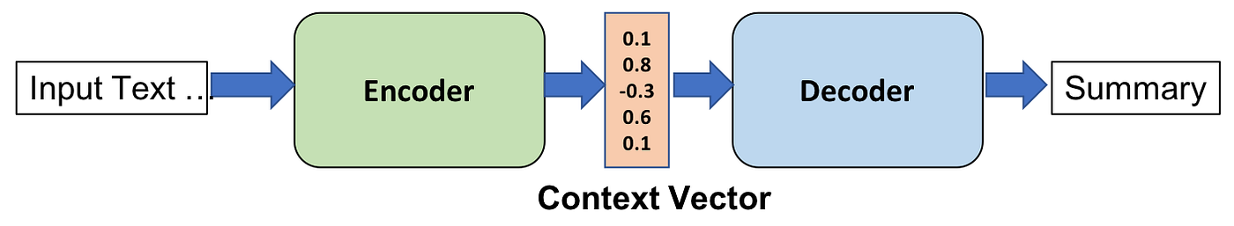
Context Vector
A context vector, c, is a function of h (hidden state which is a vector that represents the learned features or the representation of the input at a particular time step t), and it
conveys the essence of the input to the decoder.

Slide 10
Decoder
Decoder Process
After processing the entire input sequence, the encoder sends the context over to the decoder, which begins producing the output
sequence item by item

Slide 11
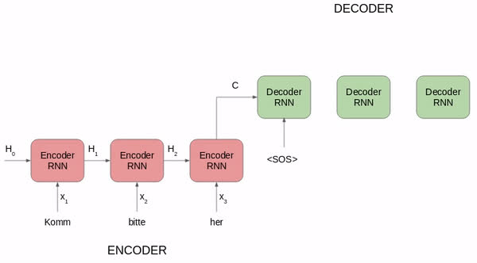
Seq2Seq

Slide 12

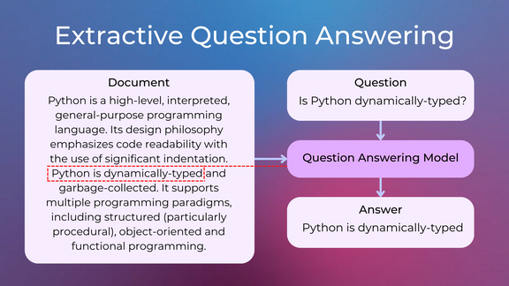


Applications and Popularity
Encoder-decoder networks have been applied to a
very wide range of applications including:
Question Answering
Sentiment Analysis
Machine Translation

Slide 13
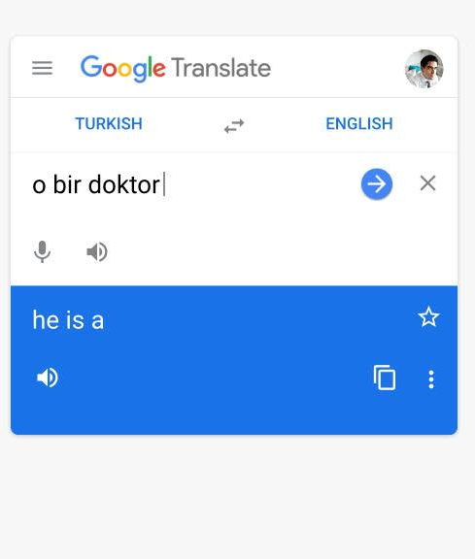


Real-World Example
Google Translate started using such a
model in production in late 2016.

Slide 14
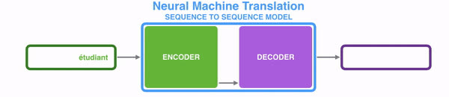
Application in Machine Translation
The same applies in the case of machine translation.
The context is a vector (an array of numbers, basically)
in the case of machine translation.
The encoder and decoder both tend to be recurrent neural networks.

Slide 15

Problems with RNN
They process the input data sequentially, one after the other. Such a recurrent process does not make use of modern graphics processing units (GPUs), which were designed for parallel computation and, thus, makes the training of such models quite slow.

Slide 16
Problems with RNN
cannot handle Long context in a sequence.
They become quite ineffective when elements are distant from one another. This is due to the fact that information is passed at each step and the longer the chain is, the more probable the information is lost along the chain.

Slide 17
Bottleneck problem
The bottleneck problem in seq-to-seq models arises from compressing an entire input sequence into a single fixed-size context vector.
This fixed-size vector may fail to capture all relevant details, especially for long sequences, leading to information loss.
The encoder's output, limited to a fixed dimension, cannot adequately represent long-range dependencies within the input sequence.
1
2
3

Slide 18
Bottleneck problem
As a result, the model's performance degrades on tasks involving lengthy or complex sequences.
Attention mechanisms
address this by allowing the decoder to dynamically focus on different parts of the input sequence, mitigating the information bottleneck.
4
5

Slide 19
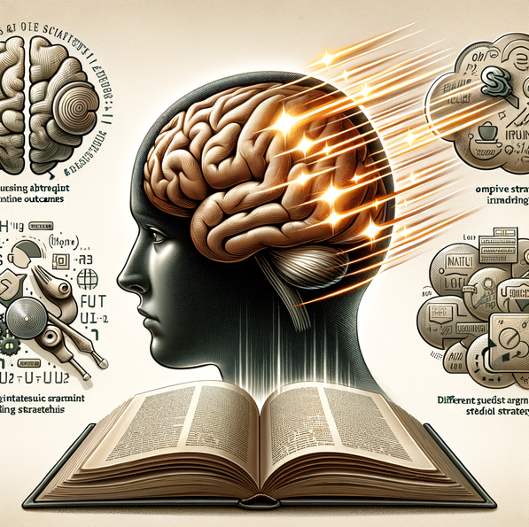
The Problem with Traditional Learning Models
Challenges with Traditional Models
Traditional models struggle with remembering long stories or instructions.
Example: Reading a long book and forgetting key details from the beginning.

Slide 20
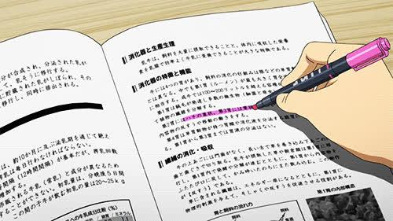
The Concept of Attention
What is Attention?
Attention helps computers focus on important
parts of information.
Analogy: Like using a highlighter to
mark important lines in a book.

Slide 21
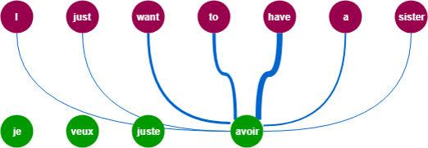
How Attention Works

Slide 22

How Does Attention Work?
Step 1: Finding Important Parts
Model look at each part and decide how important it is.
Step 2: Giving Scores
Each part gets a score based on its importance.
Step 3: Focusing More on Important Parts
Higher scores mean more focus on those parts.

Slide 23
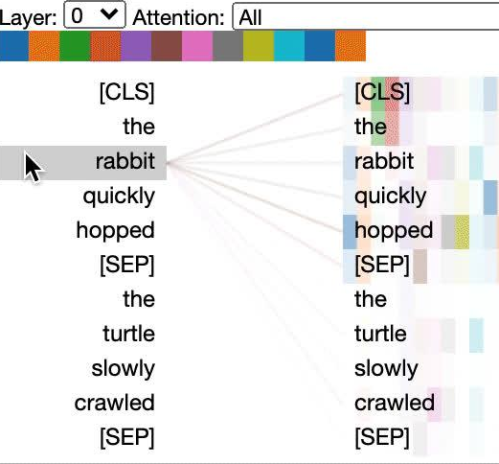
Attention in Action
Example: Translating a Sentence
With Attention: Computers focus on
key words for better translation.

Slide 24
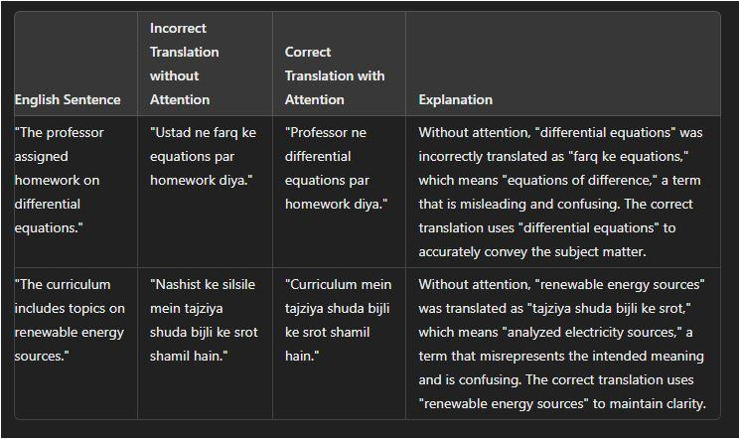
Attention in Action
Example: Translating a Sentence
Before Attention: Computers might miss important context.

Slide 25

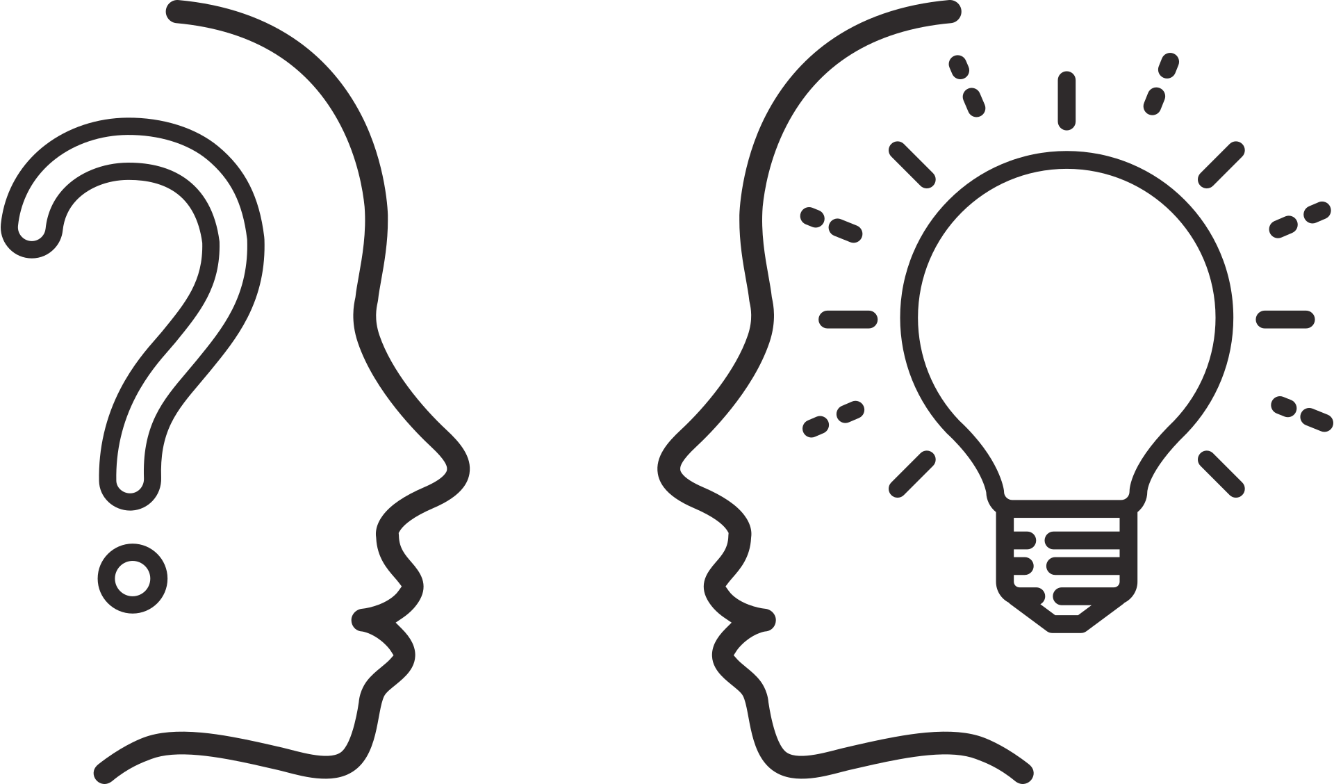

Q&A
Questions and Discussion

